Slide 1
Tillamook County: 2020 Strategic Vision 2009 Indicator Assessment
The Vital Tillamook Indicator Project
Notes:
This project is a collaborative effort of the Tillamook County Futures Council and Oregon State University faculty members jointly affiliated with Extension Service and the Rural Studies Program.
Funding was provided by the Ford Family Foundation.

Slide 2
Community Vitality Assessment Methodology
Community vitality: Capacity to work productively together and realize positive social, economic, and environmental outcomes
Developed 50 indicators of Tillamook County: 2020 Strategic Vision
Gathered data from:
Federal, State, County, and City agencies
Local organizations and businesses
Tillamook County adult residents and property owners
Developed indicator targets
Made assessment of community vitality
The Vital Tillamook Indicator Project
Notes:
Community vitality is a concept that OSU faculty in the Rural Studies Program have been working on understanding and developing for the last few years.
We have developed a broad definition of vitality that can be applied to all communities, based on past research in the field of community studies:
Vital communities are those in which residents work well together and realize positive social, economic, and environmental outcomes
Adopting this broad definition allows specific communities to determine what the specific outcomes are in each of these areas for themselves.
Partnering with the Tillamook County Futures Council, we developed 50 indicators of Tillamook County: 2020 Strategic Vision in order to gain insight into the community-level definition of community vitality and to learn how close Tillamook County is to realizing the goals set forth in the vision.
The county’s strategic vision quite clearly articulates what the goals for the county are in the areas of capacity, social issues, the economy, and the environment.
Also, the strategic vision was created with the input of community residents and property owners, so we know that the vision captures the values held by residents.
Through this collaboration OSU and Tillamook County are learning about the community
After developing the indicators and measures, we gathered data from:
Agencies and organizations with web-accessible public databases
Local organizations and businesses with program information or information about the population they serve
Adult residents of Tillamook County through an survey instrument that we developed especially for this project
Once we had all the indicator data compiled, the Tillamook County Futures Council set target levels for most indicators. Other indicator targets correspond to thresholds set by agencies such as the OR Department of Environmental Quality or OR Department of Fish & Wildlife
Finally, we made our assessment of vitality comparing the most recent indicator data with the target level

Slide 3
Vital Tillamook Indicator Project Survey
Mail Survey Methodology:
Conducted July-August, 2009
Response rate: 46%
Received completed questionnaires from 696 randomly selected Tillamook County adult (18+) residents and property owners
Quotas established for age, area, and resident status to ensure a representative sample and to focus resources on permanent residents
Margins of error:
±3.7% for permanent and seasonal resident estimates
± 4.2% for permanent resident estimates
± 7.1% for seasonal resident estimates
All published estimates have been weighted to represent the Tillamook County population of adult residents and property owners
The Vital Tillamook Indicator Project
Notes:
Mail Survey Methods:
Surveys sent out via mail to a sample of 1500 Tillamook County residents and property owners (seasonal residents).
Permanent Residents = Tillamook County registered voters
Seasonal Residents = People who own property in Tillamook County, but have an out-of-county mailing address
Response rate of 46% is very good for a mail survey. Response rates for mail surveys typically range 30%-40%.
We sampled in such as way as to make sure that we heard from a representative cross-section of the population. We drew our sample based on age, location in North, Central, or South County (school district lines), and permanent versus seasonal residency status. We oversampled permanent residents to conserve resources and concentrate our efforts on a population we expect to be much more impacted by local actions in the areas of the vision.
Margin of error interpretation:
For estimates (stats) that describe the combined seasonal and permanent resident population, we can be 95% confident that the true population value is + or – 4% around the estimate we’re looking at. For example, if the estimate is that 20% of permanent and seasonal residents bike, then we can be 95% confident that the true percentage of the population that bikes is somewhere between 16% and 24%.
For estimates that describe the permanent resident population only, the margin of error is also close to 4%
For estimates that describe the seasonal resident population only, the margin of error is a little bit higher, because we under-sampled this population.
In order to analyze the data, we applied standard statistical weights to the data. This is standard operating procedure in survey data analysis. The weights bring the sample better in line with the population. We applied weights that adjusted for our sampling design, and adjusted for age-specific and gender-specific population sizes.

Slide 4
2009 Community Vitality Assessment Findings
Areas of Strength | Areas of Weakness
Growth & Development | Economy
Natural Environment | Youth & Education
Society & Culture | Health & Human Services
According to the 2009 assessment, Tillamook County is roughly 50% vital, as three areas out of six did not meet target outcome levels.
The Vital Tillamook Indicator Project
Notes:
Based on the assessment of the indicator data, relative to community expectations for 2020, we found that Tillamook County has already attained success in some areas and in others there is more work to be done if goals are to be reached by 2020.
These six areas represent the six areas of the Tillamook County 2020: Strategic Vision.
Within each of the areas listed as strong or weak, there are some indicators that are strong and others that are weak. There is some diversity within each vision area, but overall in each of these areas 50% or more of the indicators were either weak or strong.
Technical Note - Just as an aside, within each area, the number of indicators that met or exceeded goal:
G & D: 4 out of 8
Econ: 0 out of 8
Nat Environment: 3 out of 8
S & C: 6 out of 7
Y & Ed: 2 out of 6
H & HS: 3 out of 9
Make note of: In this presentation we will not have time to discuss each of the 50 indicators, instead I will present highlights from each of the vision areas.

Slide 5
Growth & Development
Goal 1.2
Tillamook County will need adequate infrastructure for current conditions and future growth related to water, power, sewer, roads, streets, and storm water systems.
The Vital Tillamook Indicator Project

Slide 6
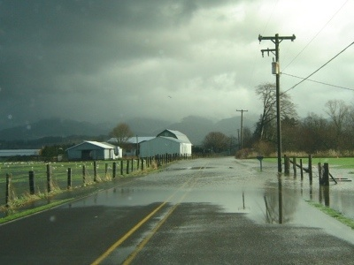
Growth & Development: Goal 1.2
Road Condition: In 2008, 64% of state roads were in good condition, while only 40% of county roads were.
Road Capacity: In 2008, there were no congested roadways in Tillamook County.
The Vital Tillamook Indicator Project
Notes:
3. Road Condition:
Data Sources – OR Dept. of Transportation for state road statistics
Tillamook County Public Works for county road statistics
Technical note – Scale for judging state road condition is different from scale used to judge county roads.
State road condition scale = very poor, poor, fair, good, very good. Our indicator = % of road miles with good or very good designation
County road condition scale = poor, fair, satisfactory, good. Our indicator = % of county road miles with satisfactory or good designation
4. Road Capacity:
Data source – OR Dept. of Transportation assessed a sample of state, county, and national roads to determine congestion
Technical note – Congestion is determined using an ODOT calculation of volume to service flow (capacity) ratio. All road segments with a volume to service flow ratio greater than 1.4 are deemed “congested” by ODOT.

Slide 7
Growth & Development
Goal 1.3
Communities throughout the county will support the use of public transportation, biking, and walking.
The Vital Tillamook Indicator Project

Slide 8
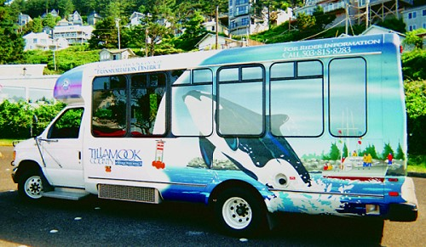
Growth & Development: Goal 1.3
Public Transportation: In 2009, 84% of the incorporated and unincorporated communities in Tillamook County were served by the WAVE.
The Vital Tillamook Indicator Project
Notes:
6. Public Transportation:
Data Source – WAVE routes mapped onto Google map of Tillamook County unincorporated and incorporated communities.
Technical Note – We made this determination of coverage with information that the WAVE makes stops anywhere along its route, not just designated stops. One can wave the bus down anywhere along the route and ask that the driver stop anywhere along the route.

Slide 9
Growth & Development: Goal 1.3
Pedestrian & Bike Access: In 2009, pedestrian access and activity was adequately high, but bicycling access and activity was lower than desired.
The Vital Tillamook Indicator Project
Notes:
7. Pedestrian & Bike Access:
Data Source – Vital Tillamook Indicator Project Survey
Technical Note – The survey questions used:
Biking & Walking Activity:
“Over the last 12 months, how frequently did you take a trip by bike in Tillamook County?”
People who indicated almost daily to a few times in the year were counted as “biking in the last year.”
Same for walking, and note that respondents were specifically told that: “For the purposes of this survey, walking from the parking lot to a building entrance should not be considered a “walk” trip. Walk trips do include travel by wheelchairs and other mobility aids.”
Satisfaction with Access to Safe Streets to bike or walk on:
“How satisfied are you with your access to safe streets and paths to walk on in Tillamook County?“
- People who indicated mostly to completely satisfied were counted as “satisfied” with their access
Same goes for biking.
Make note of:
The prevalence of biking and walking behavior is related to the feelings people have about their safety doing these activities. This issue of perceived safety is revealed in the second chart, that shows only an estimated quarter of the seasonal and permanent resident population felt they had access to safe streets to bike on.
Make mention of:
Walking and biking are becoming increasingly important in conversations about community health/ public health, and can be significant draws for visitors and second home-owners who make contributions to the local economy when they visit.
The issues related to access can be addressed via transportation planning.

Slide 10
Economy
Goal 2.3
In addition to maintaining the traditional economic base, citizens will seek to diversify the Tillamook County economy by attracting new industries and encouraging development of locally owned businesses.
The Vital Tillamook Indicator Project

Slide 11
Economy: Goal 2.3
Employment Concentration by Industry, Tillamook County, OR 2007
Source: US Bureau of Economic Analysis
Industry Diversity: On a scale of 0 to 1, where 0 indicates a completely diversified economy and 1 means it is completely homogenous, in 2008 Tillamook County scored .029. Diverse, but not quite on target (0).
Small & Large Business Health: Between 2008 and 2009, the growth rate of small businesses was 13% and for large businesses was 15%. The goal is for future growth rates to be higher.
The Vital Tillamook Indicator Project
Notes:
12. Industry Diversity:
Data Source – OR Employment Department, standard economic calculation of diversity
Technical Note – Herfindahl Index is the index used to measure industry diversity here.
Herfindahl Index = statistical measure that relies on shares of employment by industry in a locale (Tillamook County). After running the calculation, you get a standardized measure of industry diversity that can be compared across places.
Values of the index range from 0 to 1.
0 = completely diverse, no industry employs a majority of workers and
1 = completely homogenous, one industry employs the vast majority of workers.
Make note of – Tillamook County, though close to the goal of 0 is ranked 24th out of the 36 counties in Oregon. It is uncommon for non-metropolitan counties to be completely diverse. In Oregon, the top four most diverse counties were metro counties. Linn County (non-metro) was 5th and Josephine County (non-metro) was 7th.
13. Small & Large Business Health
Data Source - Oregon Employment Department
Make note of –
Small businesses = employ 0-4 people
Large businesses = employ 50 or more people
These growth rates are not bad, but moderate, therefore the goal is that by 2020 the growth rates increase.

Slide 12
Economy
Goal 2.4
Provide living wage jobs
The Vital Tillamook Indicator Project

Slide 13
Economy: Goal 2.4
2007 Cost of living (Basic Family Budget) for Tillamook County families of various compositions: |  | 2007 Average Tillamook County Earnings: | Ratio of Average Earnings to Cost of Living (single wage-earner)
1 parent with 1 child | $32,880 | $29,903 | .91
1 parent with 3 children | $54,024 |  | .55
2 parents with 1 child | $38,640 |  | .77
2 parents with 3 children | $58,452 |  | .51
Living Wage Jobs: In 2007, it was not possible for single-wage earner families of any type to support themselves with the average job in Tillamook County.
The Vital Tillamook Indicator Project
Notes:
14. Living Wage Jobs:
Data Source – Oregon Housing & Community Services, an agency of the state calculated cost of living for each county in OR
Average Earnings data come from the US Bureau of Economic Analysis
Technical Note –
Cost of Living is based on county costs of:
Housing, Food, Childcare, Transportation, Health Care, Other necessities (31% of housing and food costs), Taxes
For families of these sizes and compositions
Average TC earnings is the average of:
Wages, Salary, Pension, Insurance, and Social Security contributions made by the employer
For all jobs in the county that are covered by Unemployment Insurance. For those that are not covered by Unemployment Insurance, the BEA estimates their earnings.
Ratio of Average Earnings to Cost of Living:
Earnings divided by cost of living
Assuming a single wage-earner in the family.
Make note of –
This indicator paints a bleak picture of the Tillamook county economy, but taken in light of the previous slide that shows the share of employment by industry we note that the industries that employ the 3rd and 4th largest shares of the workforce are characterized by low-wage jobs. This explains some of the low average earnings.
Of course there are many 2-parent families in which both parents earn money outside the home, but for this analysis we assumed single wage-earner families. In instances of 2 wage-earners who earn the average for the county, clearly the average job would cover the cost of living.

Slide 14
Natural Environment
Goal 3.1
County rivers and estuaries will support magnificent runs of wild salmon. Foothills and mountains will be noted for healthy, productive forests that provide high quality habitat. Active participation in natural resource management will become institutionalized in the educational systems.
The Vital Tillamook Indicator Project

Slide 15
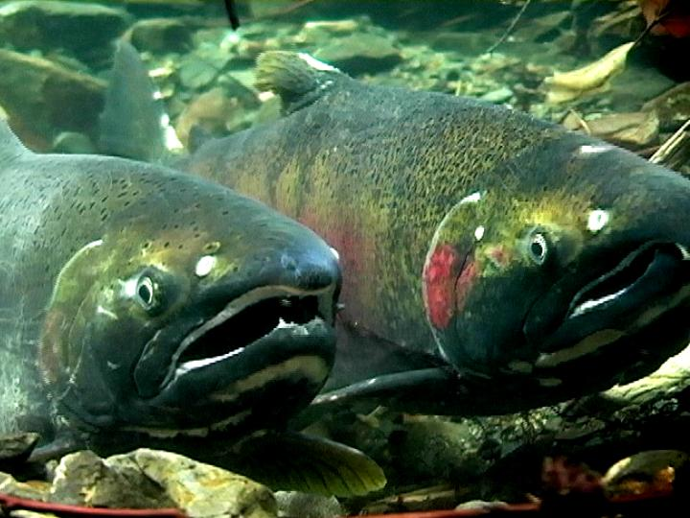
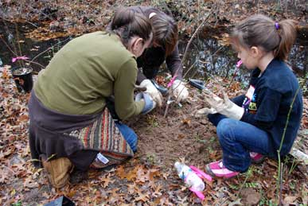
Natural Environment: Goal 3.1
Salmon Runs: In 2008, there were more than enough wild adult coho salmon spawners observed in Tillamook County to fully seed the existing high quality juvenile coho winter rearing habitat.
Land Conservation: As of 2009, only .11% of Tillamook County land is designated wilderness, preserved, or set aside; the goal is 2%.
Public Natural Resource Education: In 2009, there were 27 natural resource education programs for youth and adults through the public education system
The Vital Tillamook Indicator Project
Notes:
17. Salmon Runs:
Data Source – Oregon Department of Fish & Wildlife
ODF & W Coastal Salmonid Inventory Project - for coho estimates
ODF & W Information Report by T. Nickelson (1998) – for coho spawner abundance threshold value
Make note of: While there is considerable debate within the county over measuring salmon abundance, for the purposes of the indicator research coho was used as the salmon indicator.
19. Land Conservation:
Data Sources – The Nature Conservancy, Oregon Islands National Wildlife Refuge, Arch Rocks National Wildlife Refuge, Lower Nehalem Community Trust, US Census Bureau (for total land area)
Technical Note – 2% is the desired total percentage of land in this designation by 2020
20. Public Natural Resource Education:
Data Sources –
Tillamook Bay Community College
Oregon State University Extension Service
Tillamook County public elementary, middle, and high schools

Slide 16
Society & Culture
Goal 4.1
Tillamook County citizens will maintain the rural character of their community by conserving a high percentage of the land as farm and forestland.
The Vital Tillamook Indicator Project

Slide 17
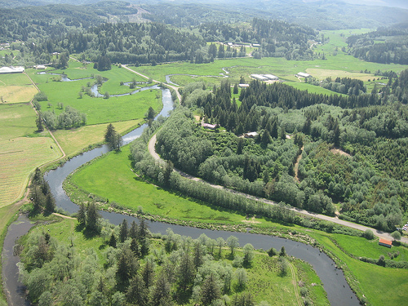
Society & Culture: Goal 4.1
Open Space: In 2009, the majority (69%) of Tillamook County land was farmland or forestland.
The Vital Tillamook Indicator Project
Notes:
25. Open Space:
Data Sources –
USDA Census of Agriculture
OR Department of Forestry
Siuslaw Nat’l. Forest
Bureau of Land Management
US Census Bureau
The Nature Conservancy
OR National Wildlife Refuge

Slide 18
Society & Culture
Goal 4.2
Tillamook County citizens will be involved with civic activities and have the capacity to work together.
The Vital Tillamook Indicator Project

Slide 19
Society & Culture: Goal 4.2
Civic Participation: Between 2008 and 2009, 50% of the adult permanent and seasonal population, and 70% of the permanent resident population participated in 2 or more civic activities in the county.
The Vital Tillamook Indicator Project
Notes:
26. Civic Participation:
Data Source – Vital Tillamook Indicator Project Survey
Technical Note – The survey question used:
Civic Activity:
“In the last 12 months in Tillamook County, have you:”
Attended any public hearings, town hall meetings, community forums, or city council meetings
Participated on the board of any local service agency or organization
Volunteered your time, in ways other than participating on the board, to any local service agency or organization
Applied or run for local public office
Donated money, services, materials, or food to any local charity groups, organizations, or associations
Helped raise money for a local charitable cause by selling items, doing a walk-a-thon, contributing items for sale, or doing anything else
Make note of –
An estimated 50% of the combined seasonal and permanent adult population participated in 2 or more civic activities in prior year
An estimated 70% of the permanent adult population participated in 2 or more civic activities in the prior year.
The top two forms of civic activity were:
Donating money, services, materials, or food to local charities, organizations, or associations
Helping raise money for local charitable causes

Slide 20
Society & Culture: Goal 4.2
Community Capacity: In 2009, Tillamook County residents felt that they worked together well as a community.
The Vital Tillamook Indicator Project
Notes:
27. Community Capacity:
Data Source – Vital Tillamook Indicator Project Survey
Technical Note – The survey question used:
Community Capacity:
Please tell us how strongly you agree or disagree regarding your community in Tillamook County:
People around here are willing to help their neighbors.
People in this community generally trust one another and get along.
If this community were faced with a local issue such as the pollution of a river, or the possible closure of a school, people here could be counted on to work together to address it.
Local government has the ability to deal effectively with important problems.
People who indicated “somewhat agree or strongly agree” were counted as agreeing with these statements
Make note of –
The relatively lower percentage of residents who perceive local government has the capacity to deal with problems is often seen in rural communities. It has been documented in rural Oregon as well as other rural communities in the nation.
When it comes down to it, overall Tillamook County residents overwhelmingly feel that their community has the capacity to work together to get things done in the community.

Slide 21
Youth & Education
Goal 5.4
Tillamook County schools will be recognized for their academic achievements.
The Vital Tillamook Indicator Project

Slide 22
Youth & Education: Goal 5.4
Educational Achievement: While young students (K-5th grade) did well 2006-2009, and high school dropout was low, reading and math achievement was very low among 8th and 10th graders.
The Vital Tillamook Indicator Project
Notes:
37. Educational Achievement:
Data Source – Oregon Department of Education, standardized test scores, dropout data, and teacher assessments of kindergartners “readiness to learn”
Make note of - High school dropout was around 2% for county high schools
Reading and math achievement scores were low for 8th graders and even lower for 10th graders

Slide 23
Youth & Education
Additional Goals
Tillamook County youth will avoid self-destructive behavior.
The Vital Tillamook Indicator Project

Slide 24
Youth & Education: Goal 5.5
Teen Pregnancy: In 2007, 40.5 teens per 1,000 age 15-19 were pregnant. Though not significantly different from state rate, residents would like to see a decrease in the future.
Teen Substance Abuse: In the 2005-2006 school year, significant proportions of 8th and 11th graders reported using drugs or alcohol.
The Vital Tillamook Indicator Project
Notes:
38. Teen Pregnancy:
Data Source - Oregon Department of Human Services
Note - Teen pregnancy in Oregon was 50.1 teens per 1,000 in 2007.
39. Teen Substance Abuse:
Data Source - Oregon Healthy Teens Survey
Technical Note – The Healthy Teens Survey is updated every school year, and in Tillamook county will be complemented by another survey developed locally to gauge health behavior and the youth interaction with their community.
Make note of –
Prevalence of substance abuse is greater among 11th graders (red bar) than 8th graders (brown bar) and alcohol is more popular than using drugs for both populations.
Only Tillamook SD and Neah-Kah-Nie SD participated in the OR Healthy Teens Survey in the 2007-2008 school year
Compared to Oregon, Tillamook was very similar:
Drug use
11th graders: 23.5%
8th graders: 14.6%
Alcohol
11th graders: 46.2%
8th graders: 28.9%

Slide 25
Health & Human Services
Goal 6.1
All Tillamook County residents will have access to affordable healthcare.
The Vital Tillamook Indicator Project

Slide 26
Health & Human Services: Goal 6.1
Delay of Health Care: Nearly half of Tillamook County permanent residents delayed seeing a health care provider because of cost, quality, or availability.
The Vital Tillamook Indicator Project
Notes:
41. Delay of Health Care:
Data source – Vital Tillamook Indicator Project Survey
Technical Note – The survey question used:
“Have you delayed getting care for any of the following reasons in the last 12 months?”
Make note of – This indicator gives us insight into the extreme of the health care situation for residents. Going outside the county is one thing, as that really only has ramifications on the county economy. Actually delaying a visit to a health care provider because you felt local choices weren’t good enough or because the cost was too high can have ramifications on people’s health.
That said, we don’t know how long people were delaying care. A delay could be anywhere from one day to six months, to 10 years, depending on the individual. All we know from these data is that almost half of the permanent resident population delayed seeing a health care professional because of cost, quality, or availability.

Slide 27
2009 Community Vitality Assessment Findings
Areas of Strength | Areas of Weakness
Growth & Development | Economy
Natural Environment | Youth & Education
Society & Culture | Health & Human Services
According to the 2009 assessment, Tillamook County is roughly 50% vital, as three areas out of six did not meet target outcome levels.
The Vital Tillamook Indicator Project
Notes:
In sum, again, we note that within each of the 6 Strategic Vision areas there is diversity with respect to the performance of specific indicators. Overall, however, we do note a trend in the vision areas. The areas of strength for the county relate to the built and natural environment and the sense of community that exists in the county (also related to community infrastructure). These are certainly areas to be proud of and to maintain into the future.
The areas in need of attention relate to people; not necessarily how they get along with each other, but how well they are able to succeed in the county. Jobs, housing, education, youth outcomes, and services for the less fortunate stand out as needing coordinated effort, be they related to setting policy or priorities.
No one agency, organization, or group in the county can be expected to realize gains in these areas. Any attempts to deal with these issues must be undertaken as a community, perhaps even leading the community to recognize opportunities for change at the state or national level. Tillamook County exists in a larger macro-economic context and a larger political context that may render local actions to address these issues insignificant.
The most important thing I hope this assessment accomplishes is to increase awareness of county priorities and areas in need of work. This assessment can give the county some guidance as it works toward achieving the goals of the Strategic vision by 2020.

Slide 28
For more information…
Indicator Report Summary
Full Indicator Report
Tillamook County Futures Council website:
www.tillamookfutures.org
Oregon Rural Communities Explorer:
www.oregonexplorer.info/rural
Thank You!
Notes:
If anyone wants a copy of the full indicator report please contact:
Lena Etuk: lena.etuk@oregonstate.edu
Jennifer Purcell: jkpurcell@oregoncoast.com

